Slide 1
Permissioned Blockchains: Hyperledger
Bernard Parenteau
bparente@fit.edu
February 2019
Based on Hyperledger.org

Slide 2
Blockchain: Use Case
In typical business networks each participant in the network keeps their own records of all transactions between all the parties that the business interacts with.
Keeping and reconciling records is expensive because of duplication of effort and intermediaries adding costs for their services.
One solution that can increase efficiency is blockchain, shared ledger technology, that allows any participant in the network to see the one single agreed-upon transaction history.

Slide 3
Permissionless vs Permissioned Blockchains
With permissionless blockchains like the Bitcoin blockchain or the Ethereum blockchain, anyone can join the network, as well as write and read transactions.
The actors in the system are not known, which means there could be some malicious actors within the network.
Permissioned blockchains restrict membership to only approved entities and thereby reduce these security risks.
They can also limit visibility of transactions to only to the parties involved or other defined subsets of the membership population.
Both permissioned and permissionless may have smart conract capabilities.

Slide 4
Hyperledger
Hyperledger is one of the more high-profile blockchain technologies.
It uses a permissioned blockchain by default.
The Hyperledger Project began when a set of companies who were starting to pay attention to the Bitcoin, cryptocurrency, and blockchain space approached The Linux Foundation and planned a joint project within the Foundation.

Slide 5
Hyperledger
In December of 2015, The Linux Foundation, in conjunction with about 30 companies including IBM, Intel, and JP Morgan, announced the launch of the Hyperledger project.
Its first release of software was in February of 2016 with the Fabric codebase.
Initially it had been built inside of IBM, but was contributed to be part of the open-source Hyperledger project.
It was followed soon after by Sawtooth Lake from Intel.
As of early 2019, over 250 organizations support Hyperledger

Slide 6
Hyperledger
Hyperledger is a group of open source projects facilitating cross-industry distributed ledger technologies. Its focus is to support collaborative blockchain development.
It is hosted by The Linux Foundation and includes collaborators from technology, finance, banking, supply chain management, manufacturing, IoT, and other industries.
With the addition of the Ursa cryptographic library, and the recently announced Grid project, Hyperledger now consists of 12 projects (plus the 10 on the following slide)
Grid is the sixth distributed ledger framework and is specifically targeted to support supply-chain applications.
The other projects are modules that support these frameworks.

Slide 7
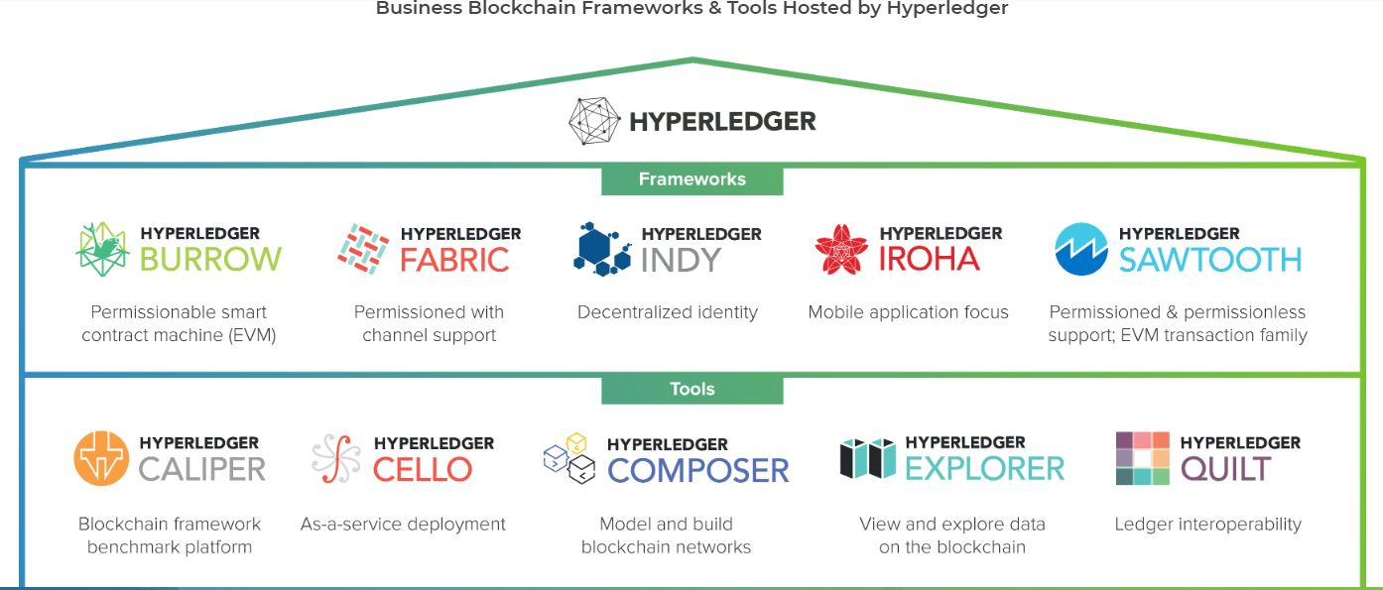
HYPERLEDGER MODULAR UMBRELLA APPROACH

Slide 8
Hyperledger
Hyperledger provides an alternative to the cryptocurrency-based blockchain model, and focuses on developing blockchain frameworks and modules to support global enterprise solutions.
Many of the features are geared towards permissioned blockchain applications that involve partial trust.

Slide 9
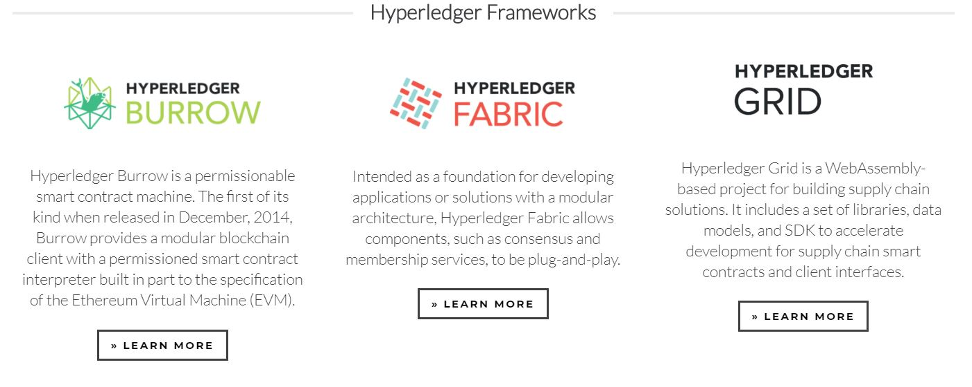
Hyperledger Frameworks
https://www.hyperledger.org/projects

Slide 10
Fabric
Fabric is Hyperledger’s most active project to date. The Fabric 1.0 release was issued in July 2017, and the latest release (as of February 2019) was 1.4.0 in January 2019.
IBM initiated the Fabric project. It’s intended as a foundation for developing blockchain distributed ledger applications with a modular architecture. It allows components, such as consensus and membership services, to be plug-and-play.
The core of the platform is written in the Go programming language, as are the applications that run on it.
A unique characteristic of Fabric is that its distributed ledger and smart contract platform allows for private channels.
If you want to share data with only certain blockchain participants, you can create a private channel with just those participants.

Slide 11
Burrow
The Burrow project includes a permissioned, smart-contract interpreter built in part to the specification of the Ethereum Virtual Machine (EVM).
The Ethereum platform is used both for cryptocurrency as well as for smart contracts and is written with the Solidity programming language.
Within the Burrow Project, the EVM is the interpreter for smart contracts (not related to cryptocurrency) that run across the Ethereum network.
The relationship with the Ethereum community is considered important to Hyperledger, and Burrow is the only Apache-licensed Ethereum VM implementation.

Slide 12
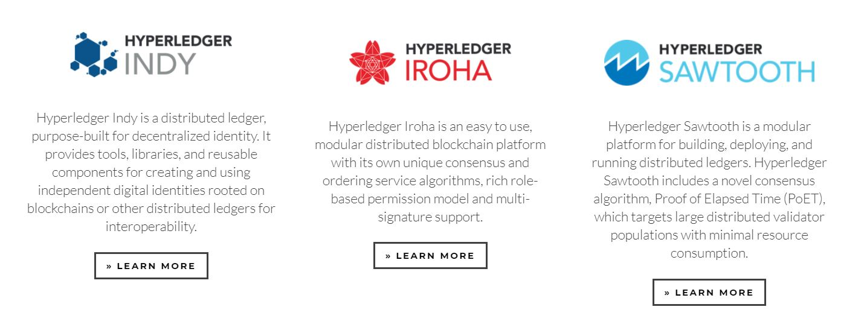
Hyperledger Frameworks (cont’d)
https://www.hyperledger.org/projects

Slide 13
Sawtooth
The Sawtooth project originally came from Intel. It includes a novel consensus algorithm called Proof of Elapsed Time (PoET).
The Sawtooth consensus software targets large distributed validator populations with minimal resource consumption.
It is designed to work with very broad and flat networks of hundreds to thousands of nodes without having the CPU burden of cryptocurrencies’ validation methods like Proof of Work.
Hyperledger Sawtooth offers an SDK to abstract away many of the complicated aspects of blockchain technology.
SDKs are available in multiple languages, including Java, Python, and Javascript.

Slide 14
Indy
The Indy project was originally the brainchild of the nonprofit group the Sorvin Foundation.
The idea is to provide digital identities for individuals and give them the power to share their identity with whom they chose.
Not only does it give the individual control over that information, it benefits companies in that they don’t have to store so much personal data, which is a potential liability (e.g. Experian and other hacks).
Instead, they can store a pointer to the identity.

Slide 15
Iroha
Hyperledger Iroha is a blockchain framework contributed by Soramitsu, Hitachi, NTT Data, and Colu.
It is designed to be simple and easy to incorporate into infrastructure projects requiring distributed ledger technology.
It emphasizes mobile application development with client libraries for Android and iOS, making it distinct from other Hyperledger frameworks.
Inspired by Hyperledger Fabric, Hyperledger Iroha seeks to complement Hyperledger Fabric and Hyperledger Sawtooth, while providing a development environment for C++ developers to contribute to Hyperledger.
Iroha features a simple construction, modern, domain-driven C++ design, along with the consensus algorithm YAC (Yet Another Consensus algorithm).

Slide 16
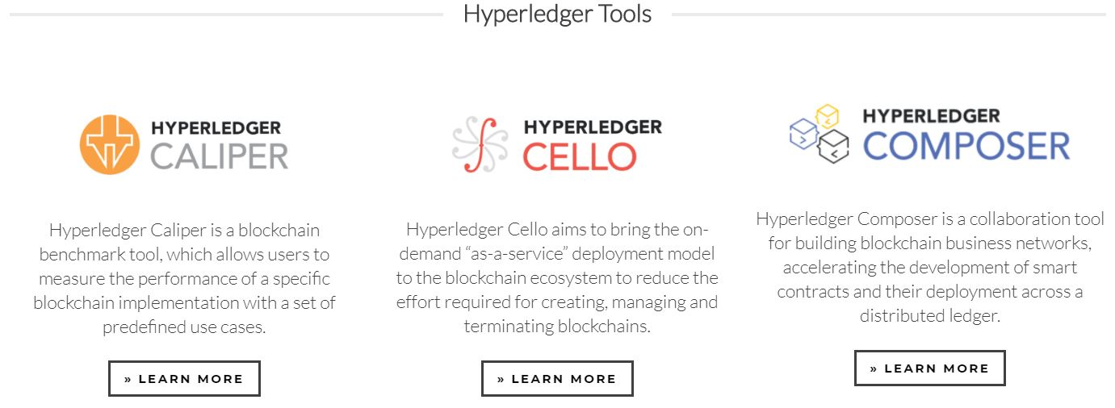
Hyperledger Tools
https://www.hyperledger.org/projects

Slide 17
Composer
Hyperledger Composer provides a suite of tools for building blockchain business networks on Fabric. These tools allow you to:
Model your business blockchain network
Generate REST APIs for interacting with your blockchain network
Generate a skeleton Angular application.
Built in Javascript, Hyperledger Composer provides an easy-to-use set of components that developers can quickly learn and implement. It abstracts some of the complexity of the Go chain code required for Fabric.
The project was contributed by Oxchains and IBM.

Slide 18
Cello
Hyperledger Cello provides a toolkit that enables Blockchain-as-a-Service.
The target market is for lean businesses and small enterprises, who want to reduce or eliminate the effort required in creating, managing, and terminating blockchains. To accomplish this, Hyperledger Cello allows blockchains deployment to the cloud.
Operators can create and manage such blockchains through a dashboard, and users (e.g. chaincode developers) can obtain a blockchain instance immediately.
Developers and system administrators using Cello can provision and maintain Hyperledger networks in virtual clouds known as 'container clusters', and then, manage and monitor those networks with a configurable dashboard.
Cello can also be used to build a Blockchain-as-a-Service (BaaS) platform.
Hyperledger Cello was initially contributed by IBM, with sponsors from Soramitsu, Huawei, and Intel.

Slide 19
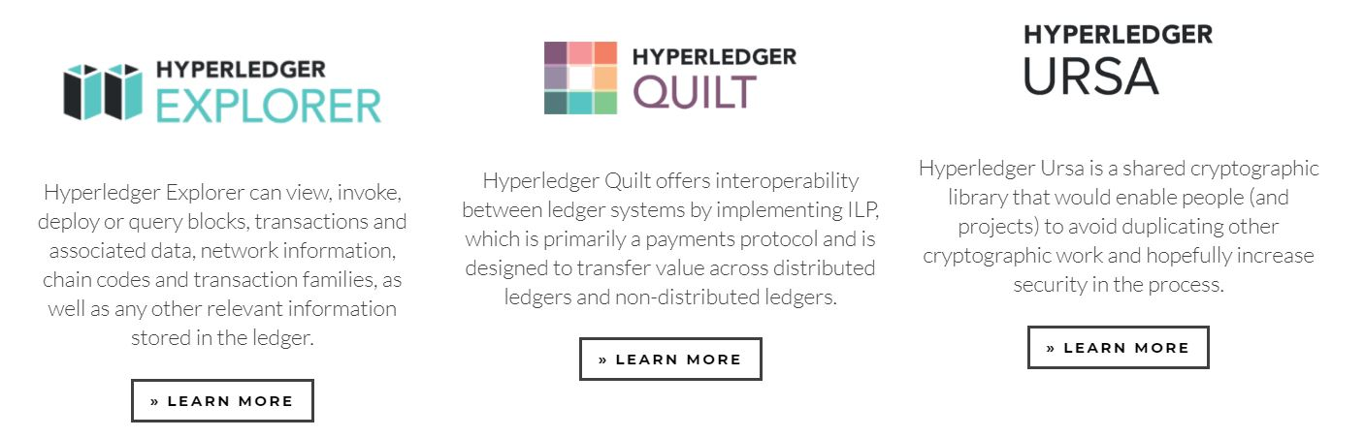
Hyperledger Tools (cont’d)
https://www.hyperledger.org/projects

Slide 20
Explorer
Hyperledger Explorer is a tool for visualizing blockchain operations. It is the first ever blockchain explorer for permissioned ledgers, allowing anyone to explore the distributed ledger projects being created by Hyperledger's members from the inside, without compromising their privacy.
Designed to create a user-friendly web application, Hyperledger Explorer can view, invoke, deploy, or query:
Blocks, Transactions and associated data
Network information (name, status, list of nodes)
Smart contracts (chain codes and transaction families)
Other relevant information stored in the ledger.
The ability to visualize data is of critical importance, in order to extract business value from it. Hyperledger Explorer provides this much needed functionality. Key components include a web server, a web UI, web sockets, a database, a security repository, and a blockchain implementation.
The project was contributed by DTCC, Intel, and IBM.

Slide 21
Hyperledger Modularity
Business blockchain requirements vary.
Speed, scalability, confidentiality, compliance, workflow complexity, and even security requirements differ drastically across industries and uses.
For these reasons, Hyperledger incubates and promotes a range of business blockchain technologies including distributed ledgers, smart contract engines, client libraries, graphical interfaces, utility libraries, and sample applications.
Hyperledger’s umbrella strategy encourages the re-use of common building blocks via a modular architectural framework.
This enables rapid innovation of distributed ledger technology (DLT), common functional modules, and the interfaces between them.
The benefits of this modular approach include extensibility, flexibility, and the ability for any component to be modified independently without affecting the rest of the system.

Slide 22
Architecture Overview
All Hyperledger projects follow a design philosophy that includes a modular extensible approach, interoperability, an emphasis on highly secure solutions, a token-agnostic approach with no native cryptocurrency, and the development of a rich and easy-to-use Application Programming Interface (API).
The Hyperledger Architecture WG has distinguished the following business blockchain components:
Consensus Layer - Responsible for generating an agreement on the order and confirming the correctness of the set of transactions that constitute a block.
Smart Contract Layer - Responsible for processing transaction requests and determining if transactions are valid by executing business logic.
Communication Layer - Responsible for peer-to-peer message transport between the nodes that participate in a shared ledger instance.
Data Store Abstraction - Allows different data-stores to be used by other modules. LevelDB is the default, and CouchDB is another built-in option.

Slide 23
Architecture Overview Blockchain components (cont’d)
Crypto Abstraction - Allows different crypto algorithms or modules to be swapped out without affecting other modules.
Identity Services - Enables the establishment of a root of trust during setup of a blockchain instance, the enrollment and registration of identities or system entities during network operation, and the management of changes like drops, adds, and revocations. Also, provides authentication and authorization.
Policy Services - Responsible for policy management of various policies specified in the system, such as the endorsement policy, consensus policy, or group management policy. It interfaces and depends on other modules to enforce the various policies.
APIs - Enables clients and applications to interface to blockchains.
Interoperation - Supports the interoperation between different blockchain instances.

Slide 24
Consensus
Consensus must provide the following core functionality:
Confirms the correctness of all transactions in a proposed block, according to endorsement and consensus policies.
Agrees on order and correctness and hence on results of execution (implies agreement on global state).
Interfaces and depends on smart-contract layer, if applicable, to verify correctness of an ordered set of transactions in a block.
The operating assumption for Hyperledger developers is that business blockchain networks will operate in an environment of partial trust.
Given this, standard PoW consensus approaches with anonymous miners are purposely not included, as these approaches impose too great a cost in terms of resources and time to be optimal for business blockchain networks.
Many PoS methods are also not applicable given partial trust.

Slide 25
Comparison of Consensus Types
Alternatives to PoW and PoS algorithms that may be more applicable to partial trust blockchains such as Hyperledger include lottery and voting-based methods.
Each of these approaches targets different network requirements and fault tolerance models.
The lottery-based algorithms are advantageous in that they can scale to a large number of nodes since the winner of the lottery proposes a block and transmits it to the rest of the network for validation.
On the other hand, these algorithms may lead to forking when two “winners” propose a block.
Each fork must be resolved, which results in a longer time to finality.

Slide 26
Consensus Algorithms
The voting-based algorithms are advantageous in that they provide low-latency finality; no potential forking to be resolved.
When a majority of nodes validates a transaction or block, consensus exists and finality occurs.
Because voting-based algorithms typically require nodes to transfer messages to each of the other nodes on the network, the more nodes that exist on the network, the more time it takes to reach consensus.
This results in a trade-off between scalability and speed.

Slide 27
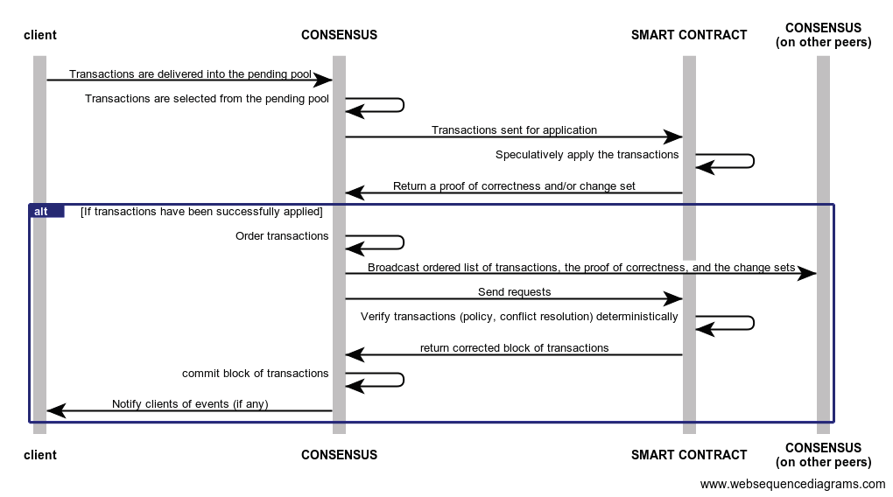
GENERALIZED HYPERLEDGER CONSENSUS PROCESS FLOW
https://www.hyperledger.org/wp-content/uploads/2017/08/Hyperledger_Arch_WG_Paper_1_Consensus.pdf

Slide 28
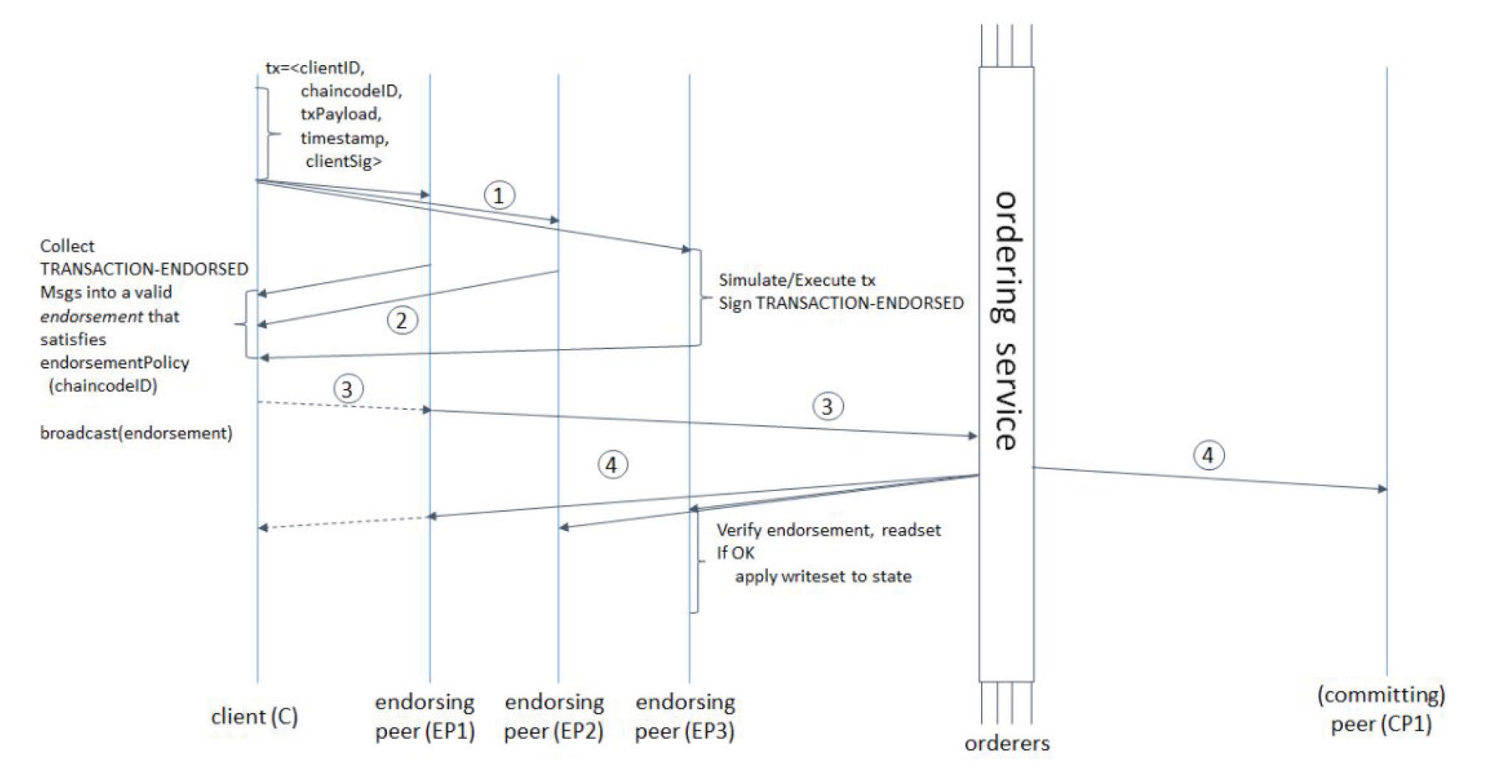
ONE POSSIBLE TRANSACTION FLOW (COMMON-CASE PATH) IN HYPERLEDGER FABRIC
https://www.hyperledger.org/wp-content/uploads/2017/08/Hyperledger_Arch_WG_Paper_1_Consensus.pdf

Slide 29
Consensus in Hyperledger Sawtooth
Hyperledger Sawtooth facilitates pluggable consensus for both lottery and voting algorithms.
By default, Hyperledger Sawtooth uses a lottery-based consensus algorithm called PoET.
PoET uses a lottery for leader election based on a guaranteed wait time provided through a Trusted Execution Environment (TEE)
The current implementation of Hyperledger Sawtooth builds on a TEE provided by Intel’s Software Guard Extensions (SGX). (https://software.intel.com/en-us/sgx)
This ensures the safety and randomness of the leader election process without requiring the costly investment of power and specialized hardware inherent in most “proof” algorithms.
Every PoET validator requests a random time to wait from a trusted function before claiming leadership. The validator with the shortest wait time for a particular transaction block is implicitly elected the leader.
https://sawtooth.hyperledger.org/docs/core/releases/1.0/architecture/poet.html

Slide 30
Sawtooth and PoET
The PoET leader election algorithm meets the criteria for a good lottery algorithm.
It randomly distributes leadership election across the entire population of validators with a distribution that is similar to what is provided by other lottery algorithms.
The probability of election is proportional to the resources contributed, where resources are general purpose processors with a TEE.
An attestation of execution provides information for verifying that the certificate was created within the TEE and that the validator waited the allotted time.
Further, the low cost of participation increases the likelihood that the population of validators will be large, increasing the robustness of the consensus algorithm.

Slide 31
Hyperledger Fabric Model
Key Design Features:
Assets - Asset definitions enable the exchange of almost anything with monetary value over the network, from whole foods to antique cars to currency futures.
Chaincode - Chaincode execution is partitioned from transaction ordering, limiting the required levels of trust and verification across node types, and optimizing network scalability and performance.
Ledger Features - The immutable, shared ledger encodes the entire transaction history for each channel, and includes SQL-like query capability for efficient auditing and dispute resolution.
Privacy through Channels - Channels enable multi-lateral transactions with the high degrees of privacy and confidentiality required by competing businesses and regulated industries that exchange assets on a common network.
Security & Membership Services - Permissioned membership provides a trusted blockchain network, where participants know that all transactions can be detected and traced by authorized regulators and auditors.
Consensus - a unique approach to consensus enables the flexibility and scalability needed for the enterprise.
http://hyperledger-fabric.readthedocs.io/en/release/fabric_model.html

Slide 32
Assets
Assets can range from the tangible (real estate and hardware) to the intangible (contracts and intellectual property), with a user-defined set of properties.
Hyperledger Fabric provides the ability to modify assets using chaincode transactions.
Assets are represented in Hyperledger Fabric as a collection of key-value pairs, with state changes recorded as transactions on a Channel ledger.
Assets can be represented in binary and/or JSON form.
You can easily define and use assets in your Hyperledger Fabric applications using the Hyperledger Composer tool.

Slide 33
Chaincode
Chaincode is software defining an asset or assets, and the transaction instructions for modifying the asset(s); it’s the business logic, or the smart contract.
Chaincode enforces the rules for reading or altering key value pairs or other state database information.
Chaincode functions execute against the ledger’s current state database and are initiated through a transaction proposal.
Chaincode execution results in a set of key value writes (write set) that can be submitted to the network and applied to the ledger on all peers.

Slide 34
The Ledger, Transactions
The ledger is the sequenced, tamper-resistant record of all state transitions in the fabric; the blockchain.
State transitions are a result of chaincode transactions submitted by participating parties.
Transactions consist of the versions of keys/values that were read in chaincode (read set) and keys/values that were written in chaincode (write set).
Transactions contain signatures of every endorsing peer and are submitted to ordering service.
Transactions are ordered into blocks and are “delivered” from an ordering service to peers on a channel.

Slide 35
Ledger Features
So the ledger is comprised of a blockchain to store the immutable, sequenced record in blocks, as well as a state database to maintain current fabric state.
There is one ledger per channel.
Each peer maintains a copy of the ledger for each channel of which they are a member.
The ledger supports
Blockchain explorer functions
Query and update using key-based lookups, range queries, and composite key queries
Read-only queries using a rich query language (if using CouchDB as state database)

Slide 36
Privacy through Channels
Hyperledger Fabric employs an immutable ledger and associated chaincode on a per-channel basis.
A ledger exists in the scope of a channel - it can be shared across the entire network (assuming every participant is operating on one common channel) - or it can be privatized to only include a specific set of participants.
And within a channel access can be more finely grained as chaincode functions can be selectively installed.
To further obfuscate the data, values within chaincode can be encrypted (in part or in total) using common cryptographic algorithms such as AES before appending to the ledger.

Slide 37
Security and Membership Services
Hyperledger Fabric underpins a transactional network where all participants have known identities.
Public Key Infrastructure is used to generate cryptographic certificates which are tied to organizations, network components, and end users or client applications.
As a result, data access control can be manipulated and governed on the broader network and on channel levels.
This “permissioned” notion of Hyperledger Fabric, coupled with the existence and capabilities of channels, helps address scenarios where privacy and confidentiality are paramount concerns.

